Slide 1
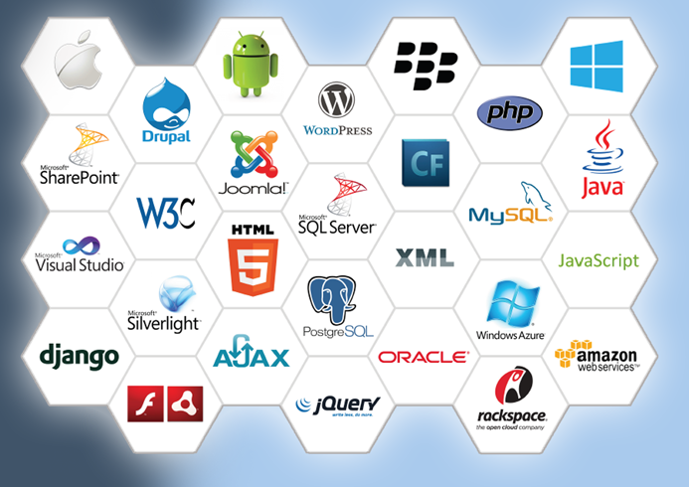
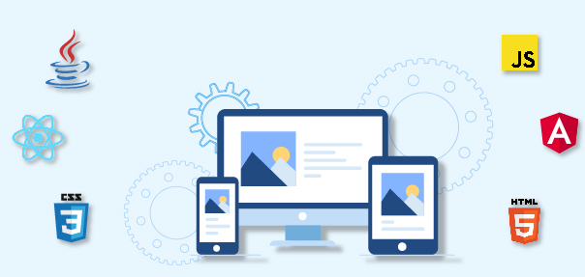
Software Technology

Slide 2
Content
Software Development Life Cycle
Software Development Framework
Software Programming Language
MVC Pattern using Python

Slide 3
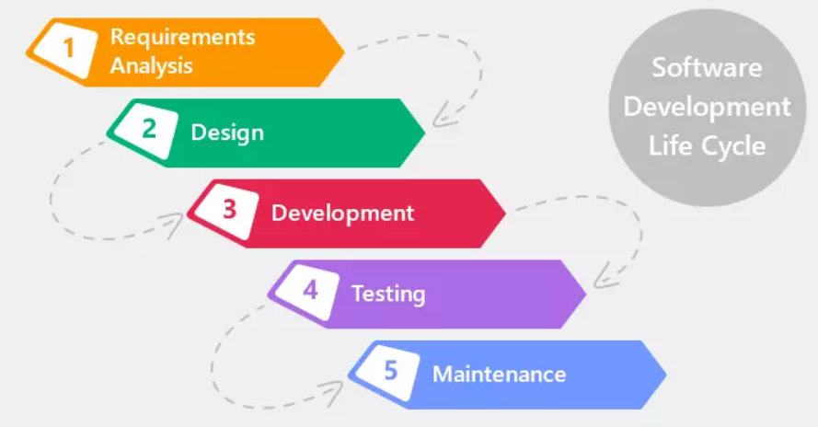
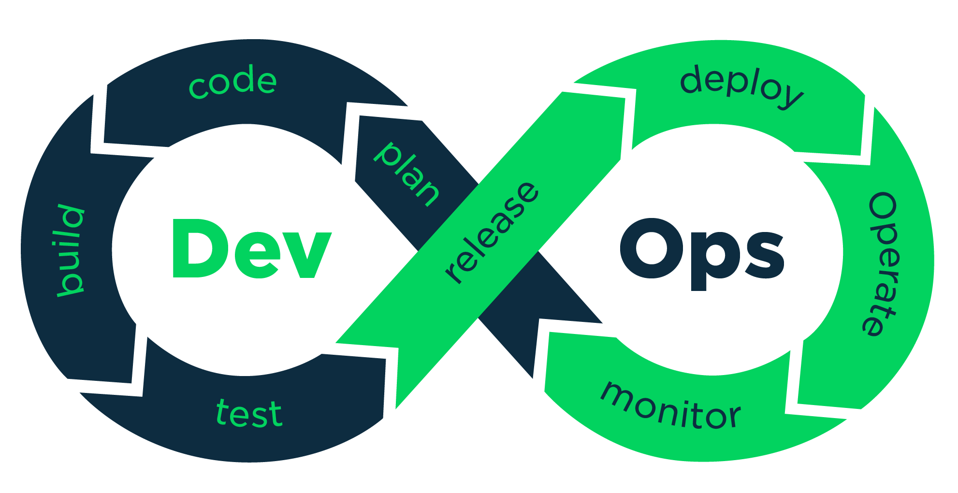
Software Development Life Cycle

Slide 4
Software Development Life Cycle
A developer mainly works in the Development phase

Slide 5
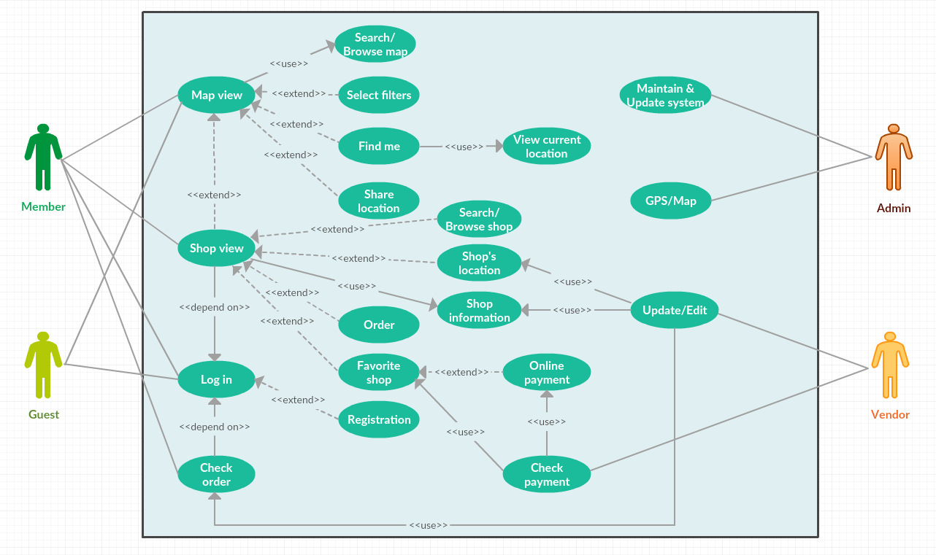
Requirement Analysis
Use-case diagram is used to model system features

Slide 6
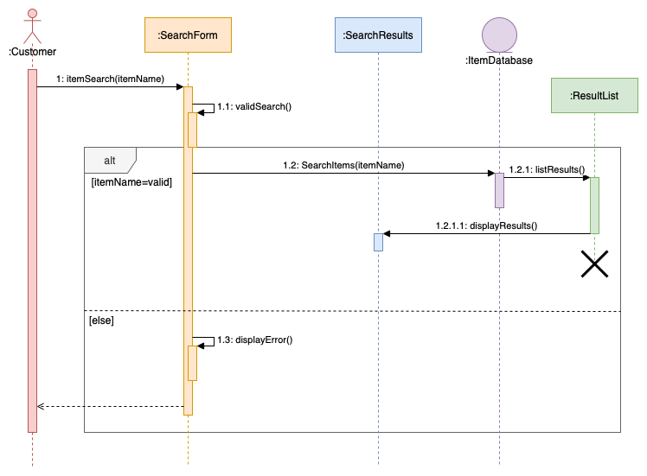
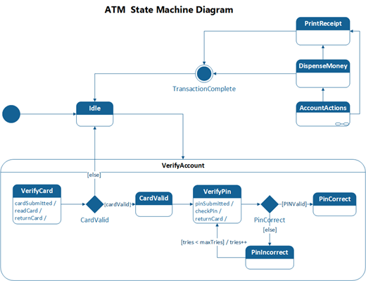
Design
Sequence diagram, Flowchart, State Machine, ….

Slide 7
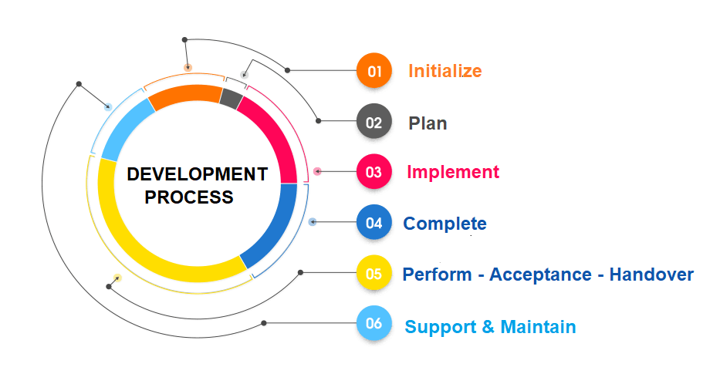
Development
CAD Tools: Github, SourceTree
Software Editors: Visual studio code
Project template: MVC model

Slide 8
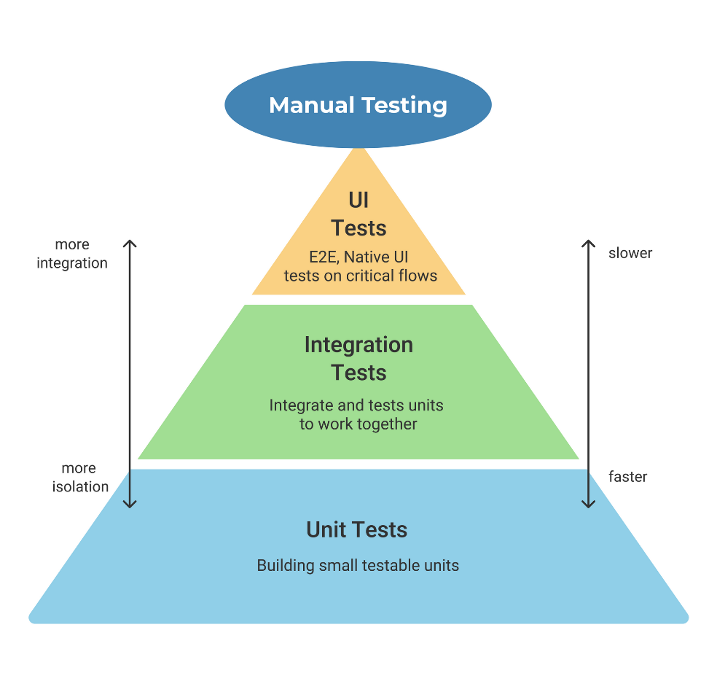
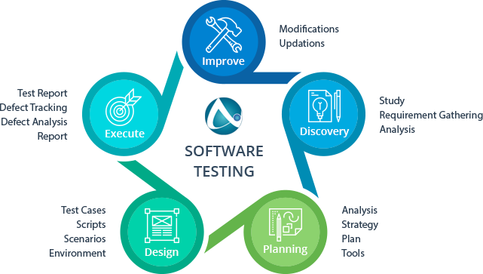
Software Testing
Validation and Performance
Testing reports

Slide 9
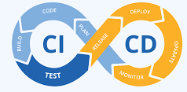
Maintenance or Operations (DevOps)
The most important phase to upgrade the project:
Error tracking
CD and CI

Slide 10
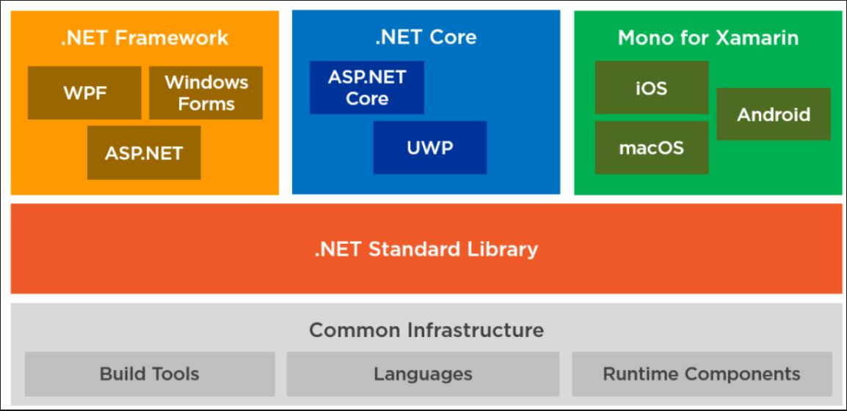
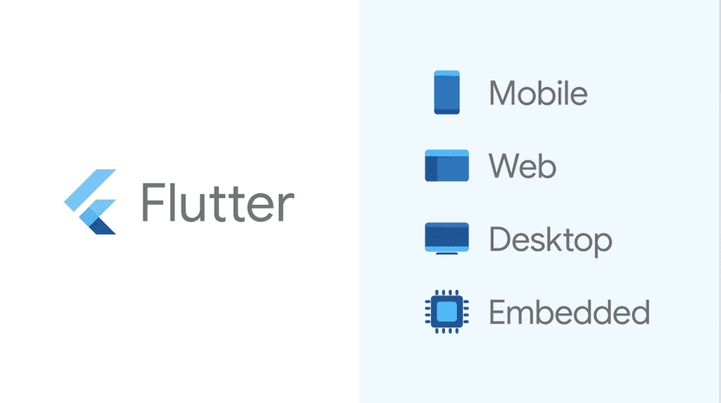
Software Development Framework

Slide 11
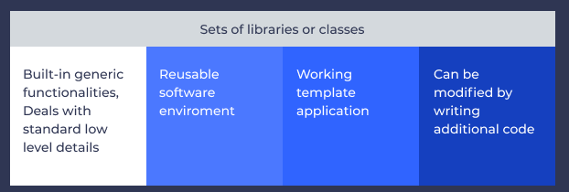
What is Software Development Framework?
Supported libraries, SDK, programming languages for software development and deployment

Slide 12
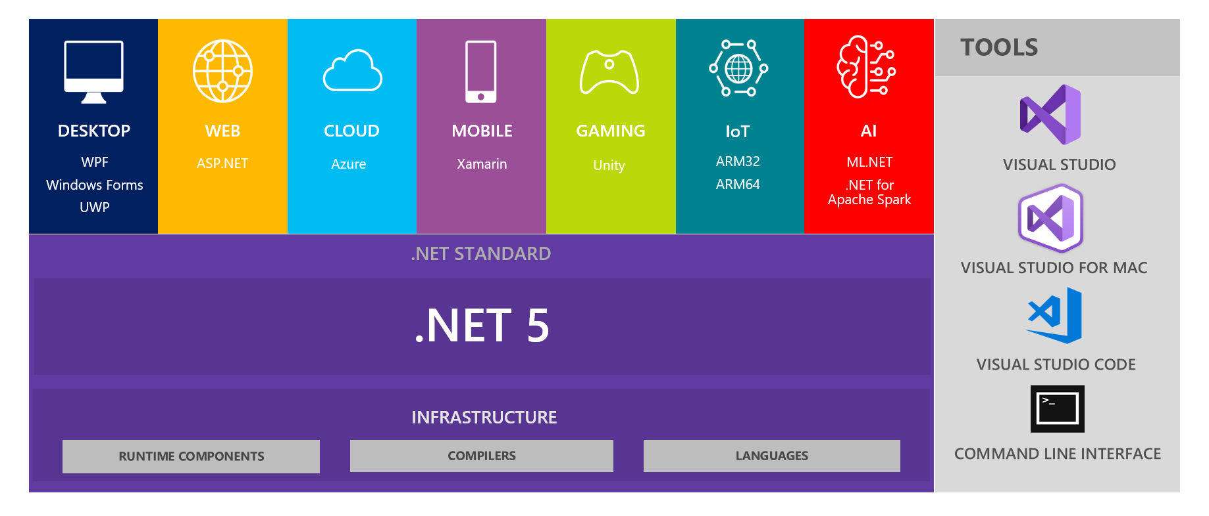
Dot Net Framework
Unify framework for Desktop Applications
C, C++ and C# are the most popular languages
Visual studio IDE: Drag and Drop!!!

Slide 13
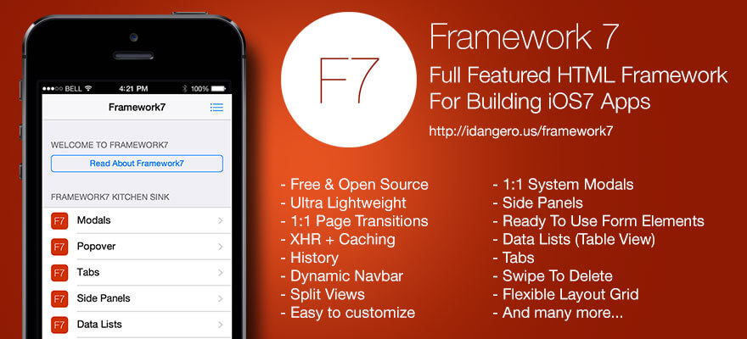
Framework 7 – React JS
https://framework7.io/react/

Slide 14
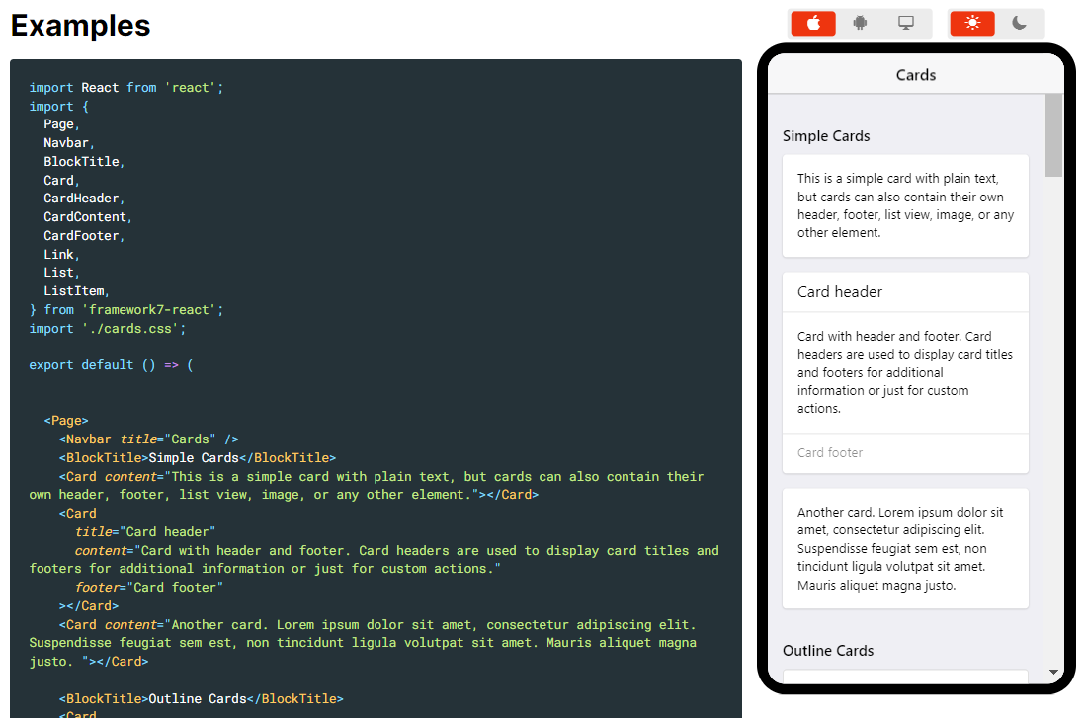
Example of Framework 7
Framework 7 Web-App development environment

Slide 15
Android Studio and Flutter
Flutter is an Android Studio plug-in:
Access to the hardware of the mobile device (Bluetooth, NFC, Wifi, …)

Slide 16
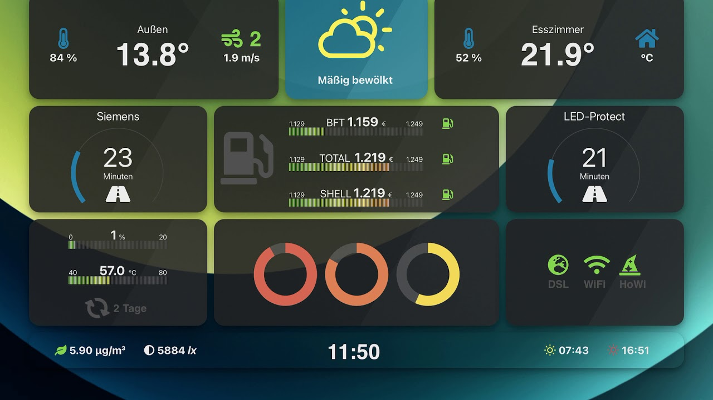
Unity 3D
A product from Microsoft
Not only for game developers, but also a cross-framework for software developemt
C# programing language

Slide 17

Unity Asset Store
https://assetstore.unity.com/templates
https://www.youtube.com/watch?v=uZaFHx1daLU

Slide 18
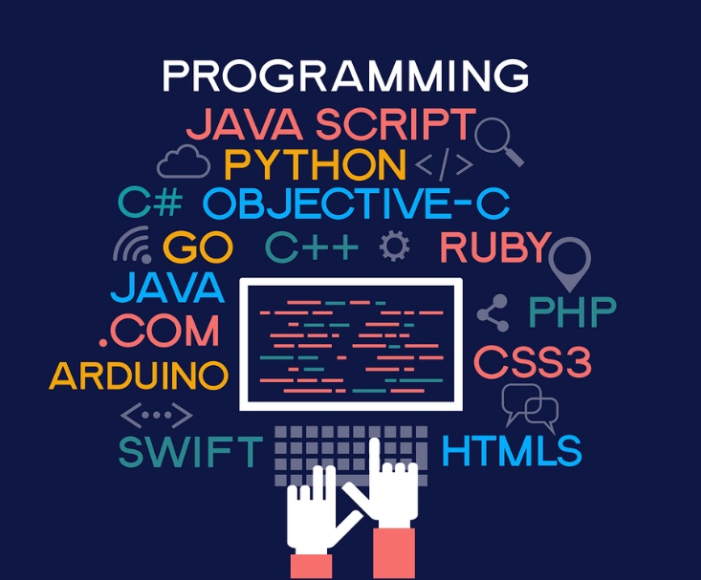
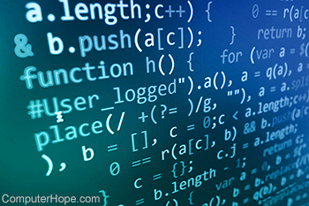
Software Programming Language

Slide 19
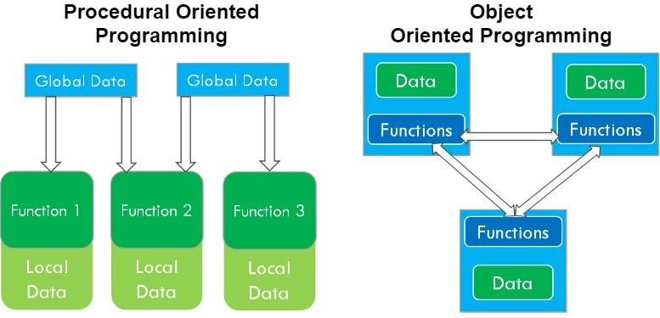
Procedure and OOP Programming Language
In procedural programming major focus is on functions rather than data
In Object Oriented Programming, focus is given on data and how to access that data and the real world scenarios share more resemblance

Slide 20
Basic concepts of OOP
Classes & Objects:
A class is a template which consists of data members
An Object is a variable of type Class
Inheritance:
When one class acquires all the properties and behaviors of parent class
Polymorphism:
When one task is performed by different ways
Abstraction:
Hiding internal details and showing functionality is known as abstraction
Encapsulation:
Binding (or wrapping) code and data together into a single unit

Slide 21
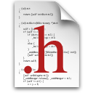
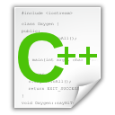
C/C++ Programming Language
The best performance program
Compiler programing language
#include “led.h”
int T_on;
int T_off;
int counter;
void setOn(long duration){
//TODO: set LED on here
}
void setoff(long duration){
//TODO: set LED off here
}
void delay(long duration){
//TODO: set delay here
}
#ifndef __LED_H_
#define __LED_H_
#include <system_lib.h>
#include “user_lib.h”
#include “UserFolder/lib.h”
extern int T_on;
extern int T_off;
void setOn(long duration);
void setoff(long duration);
#endif

Slide 22
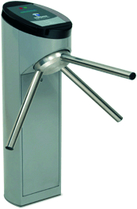
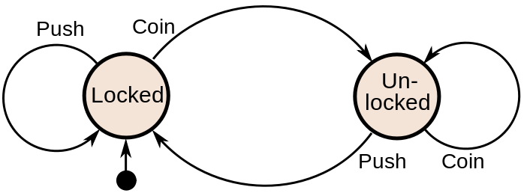
Finite State Machine (FSM)
Finite-State Machine (FSM) or Deterministic Finite Automata (DFA), finite automaton, or simply a state machine, is a mathematical model of computation
Current State | Input | Next State
Locked | Coin | Unlocked
 | Push | Locked
Unlocked | Coin | Unlocked
 | Push | Locked
A turnstile

Slide 23
Finite State Machine Programming
while(1){
switch(status){
case LOCKED: lock_turnstile(); //operation in a state
if(Coin == true) //transition condition
status = UNLOCKED; //next state
break;
case UNLOCKED:
unlock_turnstile(); //operation in a state
if(Push == true) //transition condition
status = LOCKED; //next state
break;
default:
break;
}
}

Slide 24
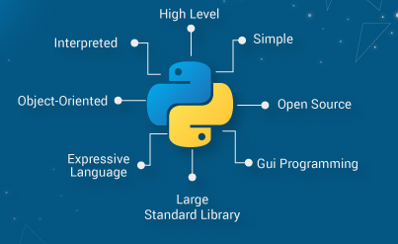
Python Programing Language
AI, Data science and Deep Learning
Interpreter programing language

Slide 25
Class in Python
class Student: def __init__(self, _name, _age): self.name = _name self.age = _age def setName(self, _name): self.name = _name
Flexible and high level approach

Slide 26
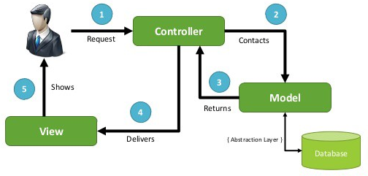
Model View Controller
A pattern for OOP program

Slide 27
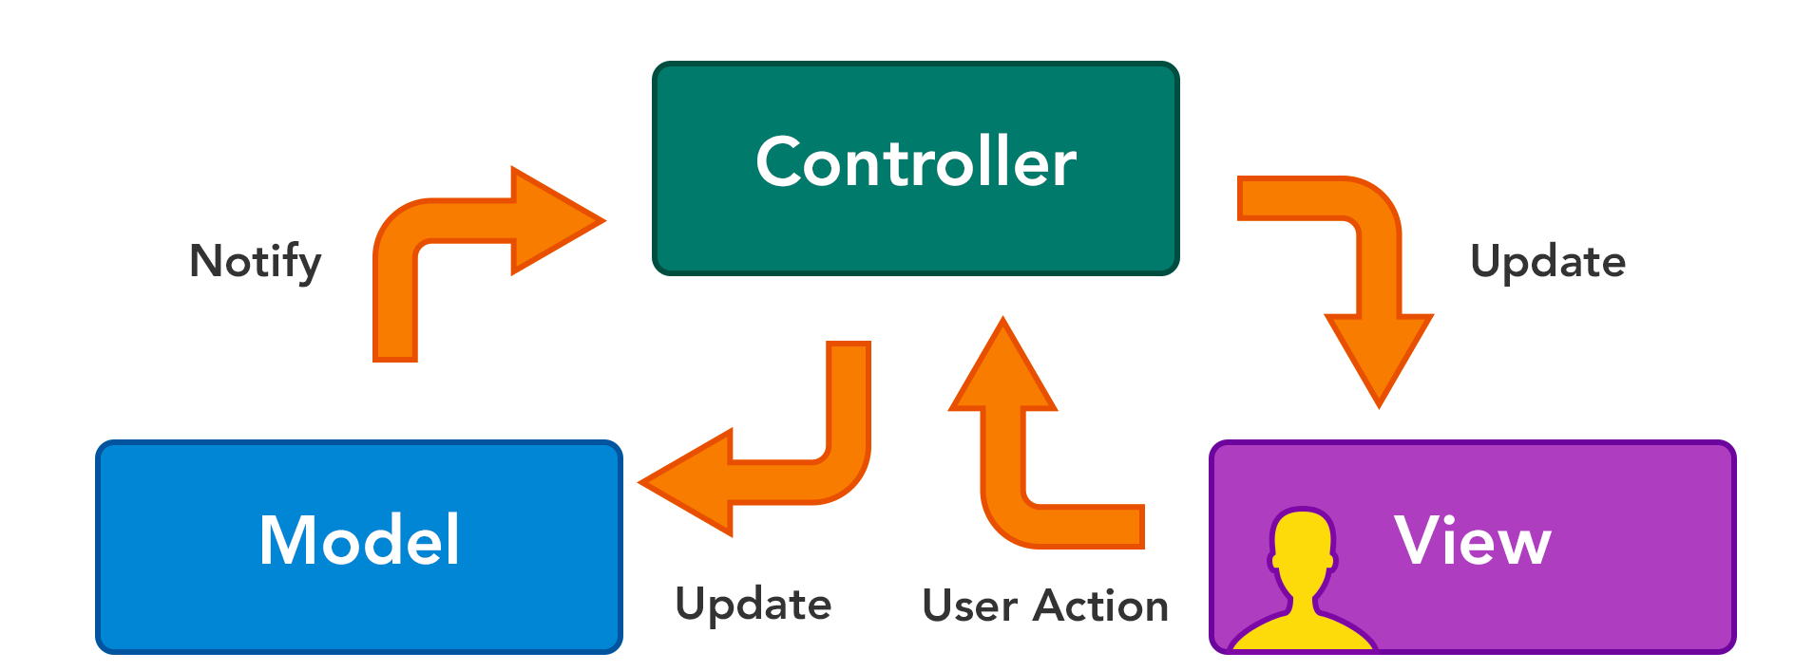
MVC using Python

Slide 28
Step 1: Create a new project in Python
Create Model folder:
Student.py
Create Controller folder:
StudentController.py
The main.py is the View of the project

Slide 29
Step 2: Implement the Student Class
class Student: def __init__(self, _name, _age): self.name = _name self.age = _age def setName(self, _name): self.name = _name def getName(self): return self.name def setAge(self, _age): self.age = _age def getAge(self): return self.age
The fields are highly related to the database properties

Slide 30
Step 3: Implement the Controller
class StudentController: def insertStudent(self, student): print(student.name, student.age)
Data manipulation: insert, update or delete
Data storage: database or file management system

